Slide 1
Visual Programming
Lecture 2
Week 1

Slide 2
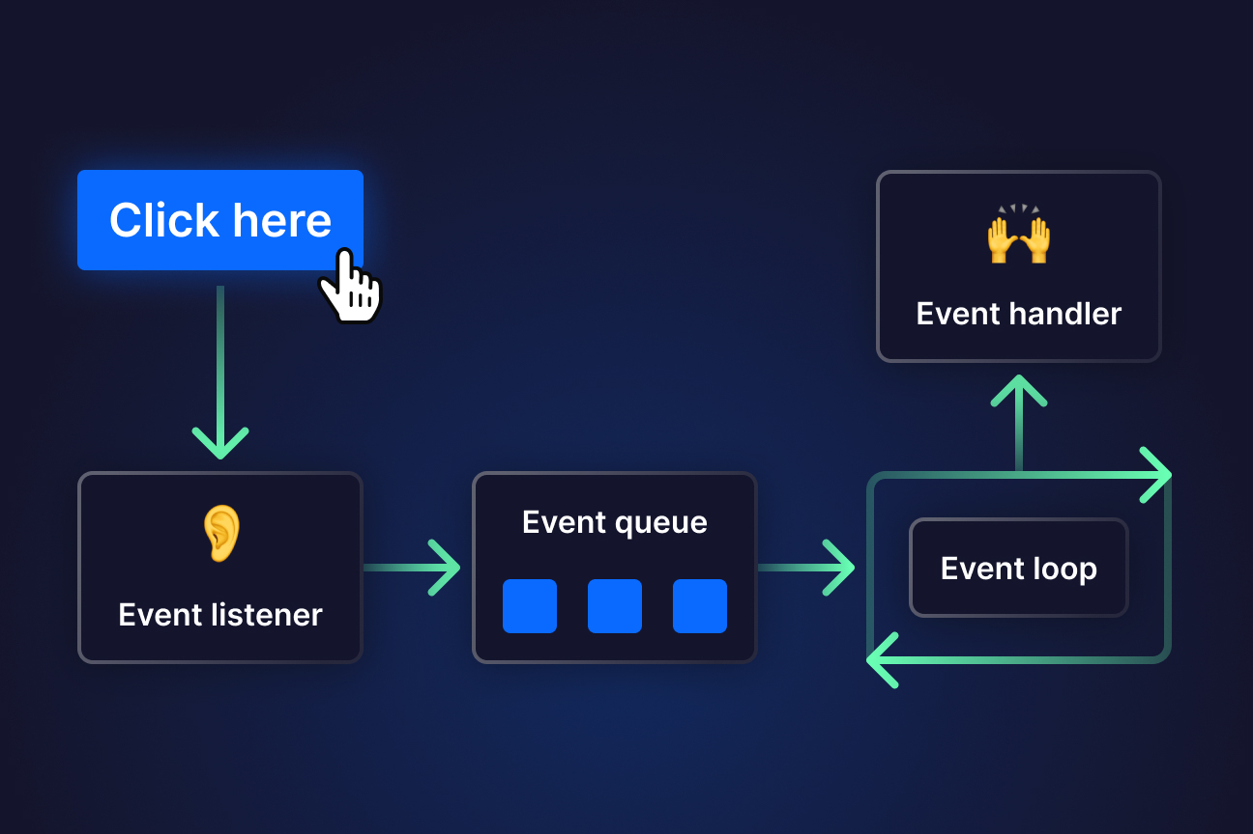
What is the Event Driven Programming Paradigm ?
Event-driven programming is a paradigm where the execution of a program is determined by events such as user actions.
Programs respond to events with predefined actions, allowing for responsive behavior, often seen in GUI applications .

Slide 3
Events: These can be user inputs, system-generated notifications, or messages from other applications.
Examples of Event-Driven Programming:
GUI Applications: Button clicks, mouse movements, and text input in applications like web browsers or mobile apps.
Game Development: Responding to player actions, collisions, or AI decisions.
Web Development: Handling user interactions, API responses, or real-time data updates (e.g., JavaScript with Node.js).
IoT Systems: Reacting to sensor data like temperature changes.

Slide 4
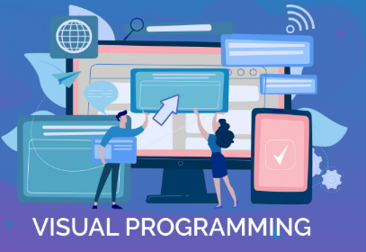
Visual Programming
Visual Programming is a programming paradigm that allows users to create programs by manipulating graphical elements rather than writing text-based code. It enables developers to design applications using drag-and-drop components, and UI-based interactions.

Slide 5
Key Features of Visual Programming:
Graphical Representation – Uses icons, diagrams, and blocks instead of traditional text-based coding.
Event-Driven Approach – Often responds to user actions like button clicks, drag-and-drop operations, and UI interactions.
Simplifies Development – Easier for beginners and non-programmers to understand.
Rapid Application Development (RAD) – Speeds up development by allowing visual design of UI and logic.
Common in GUI Development – Used in desktop, mobile, and web applications.

Slide 6
C# other than in .Net (How learning C# can benefit)
Godot
🔹 What is it?
A lightweight open-source game engine that supports C#.
Alternative to Unity for game developers.
🔹 Use Cases:
✅ 2D and 3D game development.

Slide 7
C# other than in .Net (How learning C# can benefit)
Unity (Game Development Engine)
🔹 What is it?
A popular game engine that uses C# .
Supports PC, console, mobile, and VR development.

Slide 8

Object-Oriented Programming (OOP) in C# – Basics

Slide 9
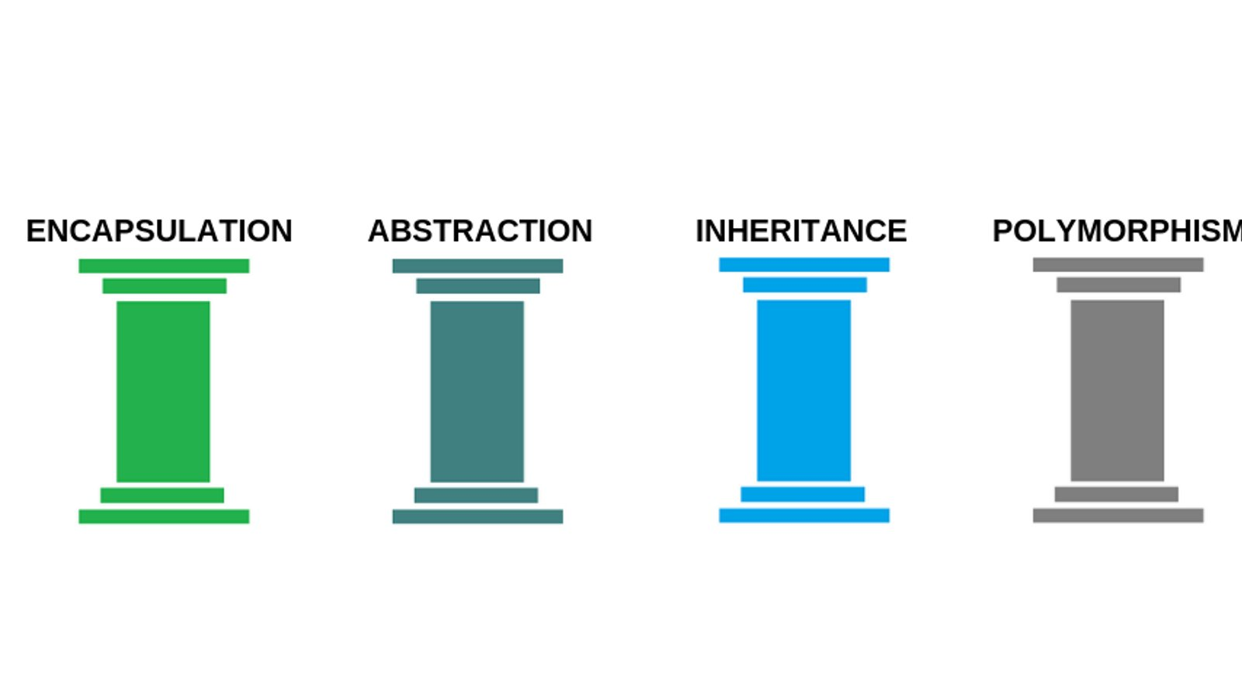

Slide 10
Object-Oriented Programming (OOP) in C# – Basics
C# is a object-oriented programming (OOP) language that follows four fundamental OOP principles:
Encapsulation : Hiding data and restricting access using classes and access modifiers. Removing access to parts of your code and making things private is exactly what Encapsulation is all about.
Abstraction : Hiding complex implementation details and exposing only relevant parts through function calls or objects method calls
Inheritance : Allowing one class to inherit from another (code reuse). Inheritance lets one object acquire the properties and methods of another object.
Polymorphism : Enabling a method or function to have different behaviors. Types in the same inheritance chains being able to do different things.

Slide 11
1. Classes and Objects
A class is a blueprint, and an object is an instance of a class.
class Car { // Class definition
public string Brand; // Data member
public void DisplayInfo() // Method
{
Console.WriteLine($"Car: {Brand}");
}
}
C# does not use a colon (:) to specify access levels for class members. Instead, each member has an explicit access modifier.

Slide 12
class Program
{
static void Main()
{
Car myCar = new Car(); // Creating an object
myCar.Brand = "Toyota";
myCar.DisplayInfo();
}
}

Slide 13
2. Encapsulation (Data Hiding)
Encapsulation means keeping fields private and exposing them through public properties (getters and setters).
Example:
private string brand; // Private field
public string Brand // Public property
{
get { return brand; }
set { brand = value; }
}

Slide 14
What is a Property in C#?
A property in C# acts as an intermediary between a private field and external access. It provides a getter (to read the value) and a setter (to modify the value) while enforcing validation or logic if needed.
class Car
{
private string brand; // Private data member
public string Brand // Property
{
get { return brand; } // Getter
set { brand = value; } // Setter
}
}
Car c = new Car();
c.Brand= “Honda”;
Console.WriteLine(c.Brand);

Slide 15
3. Polymorphism in C#
Polymorphism means "many forms", allowing the same function name or operator to behave differently based on the context.
C# supports two types of polymorphism:
Compile-time polymorphism (Method Overloading, Operator Overloading)
Run-time polymorphism (Method Overriding, Interface Implementation)

Slide 16
1. Compile-Time Polymorphism
Compile-time polymorphism occurs when method binding happens at compile time.
📌 Method Overloading
👉 Same method name, different parameters
int Add(int a, int b) => a + b; // 2 int parameters
double Add(double a, double b) => a + b; // 2 double parameters
int Add(int a, int b, int c) => a + b + c; // 3 parameters
Console.WriteLine(Add(5, 3)); // Calls int version → Output: 8
Console.WriteLine(Add(2.5, 3.5)); // Calls double version → Output: 6.0 Console.WriteLine(Add(1, 2, 3)); // Calls 3-parameter version → Output: 6

Slide 17
2. Run-Time Polymorphism (Method Overriding & Interfaces)
Run-time polymorphism occurs when method binding happens at runtime.
It is achieved through:
✅ Method Overriding (Virtual Methods)
✅ Interface Implementation
📌 Method Overriding (Using Virtual and Override Keywords)
👉 Base and Derived classes have the same method, but the derived class provides a new implementation.

Slide 18
class Animal
{
public virtual void MakeSound() // Virtual method in base class
{
Console.WriteLine("Animal makes a sound");
}
}
class Dog : Animal
{
public override void MakeSound() // Overriding the base class method
{
Console.WriteLine("Woof Woof!"); }}
class Program
{
static void Main()
{
Animal myAnimal = new Dog(); // Polymorphic behavior
myAnimal.MakeSound(); // Output: Woof Woof!
}
}
✔ Base class reference calls derived class method at runtime.
✔ Uses virtual in base class & override in derived class.

Slide 19
📌 Interface-Based Polymorphism
interface IAnimal
{
void MakeSound(); // Abstract method (must be implemented by classes)
}
class Cat : IAnimal
{
public void MakeSound()
{
Console.WriteLine("Meow Meow!");
}
}
class Dog : IAnimal
{
public void MakeSound()
{
Console.WriteLine("Woof Woof!");
}
}
You cannot instantiate an interface

Slide 20
Types of Inheritance in C#
Inheritance Type | Supported in C#? | Default Access | Behavior
Public (Dog : Animal) | ✅ Yes (default) | public | Inherited members retain original access level
Private (Dog : private Animal) | ❌ Not allowed | N/A | C# does not support private inheritance
Protected (Dog : protected Animal) | ❌ Not allowed | N/A | C# does not support protected inheritance

Slide 21
Inheritance will be continued in next lecture

Slide 22
Task
Find the famous applications developed in C#.
Why certain .Net programming languages are better than others. Give real world examples.

